Slide 1
Presented by
N.Tarani

Slide 2
Overview
Definition of arm trustzone
Need for Trustzone
Monitor Mode
Trusted Execution Environment(TEE)
Trusted Application
Boot sequence

Slide 3
Definition
Arm Trustzone is a security extension added to arm processor.
Provides system wide hardware isolation for trusted software.
Arm Cortex-A,Cortex-M23,Cortex-M33

Slide 4
Need for Trustzone
To maintain
1.Confidentiality
2.Integrity
3.Authenticity

Slide 5
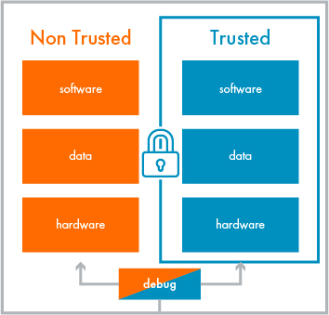

Slide 6
Monitor Mode
Mechanism to switch between normal world and secure world.
SMC
->Entry to monitor mode is triggered by software via Secure Monitor Call.

Slide 7
Trusted Execution Environment
TEE is an isolated environment that runs in parallel with the operating system providing security for the rich environment.
It consists of 3 parts
1.Hardware based isolation technology.
2.Trusted boot.
3.Trusted os.
It provides
1.High performance.
2.Access to large amount of memory.

Slide 8
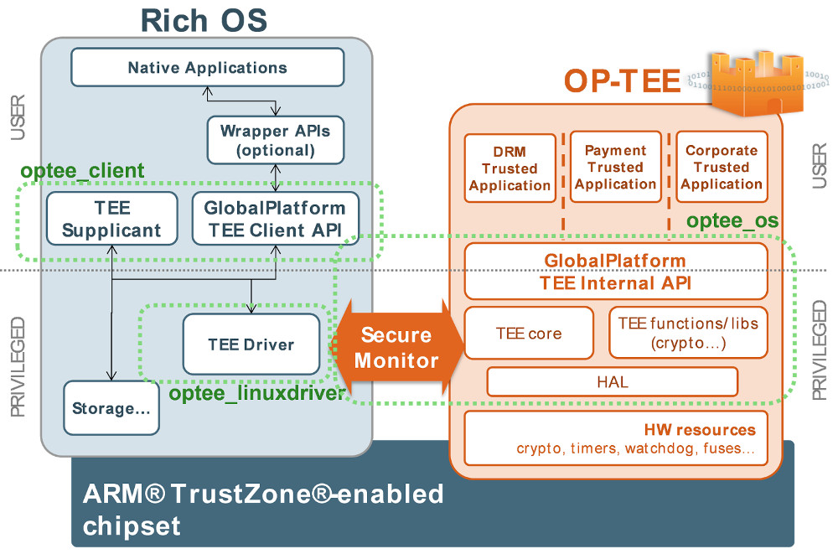
Trusted Application

Slide 9
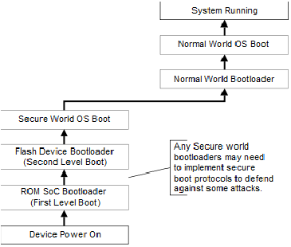
Boot Sequence

Slide 10
THANK YOU

